Slide 1
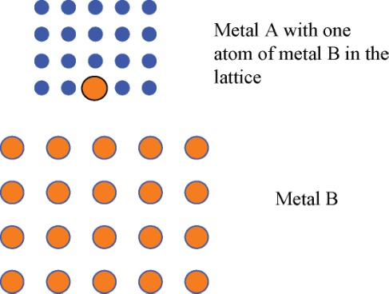
FIGURE 32.1 Schematic of Two Metals to Form an Alloy
Copyright © 2016 Elsevier Ltd. All rights reserved.

Slide 2
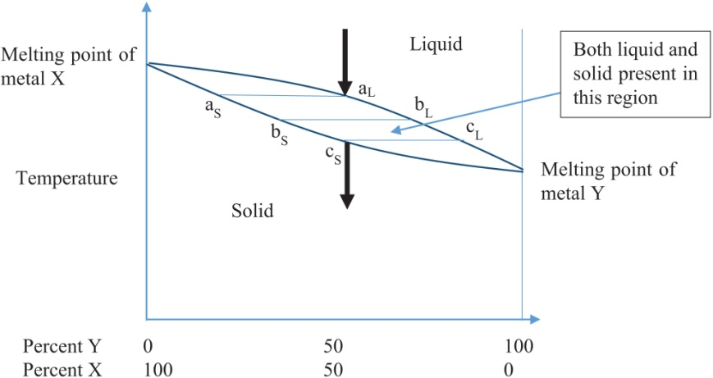
FIGURE 32.2 Cooling a Mixture of Two Completely Soluble Metals
Copyright © 2016 Elsevier Ltd. All rights reserved.

Slide 3
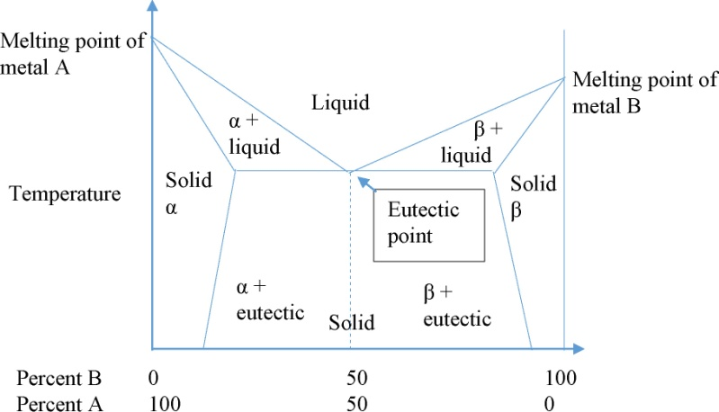
FIGURE 32.3 Mixtures of Partially Soluble Metals
Copyright © 2016 Elsevier Ltd. All rights reserved.

Slide 4
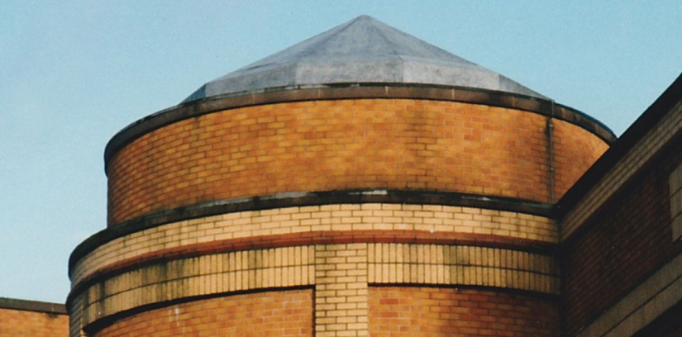
FIGURE 32.4 A Lead Roof
Copyright © 2016 Elsevier Ltd. All rights reserved.

Slide 5
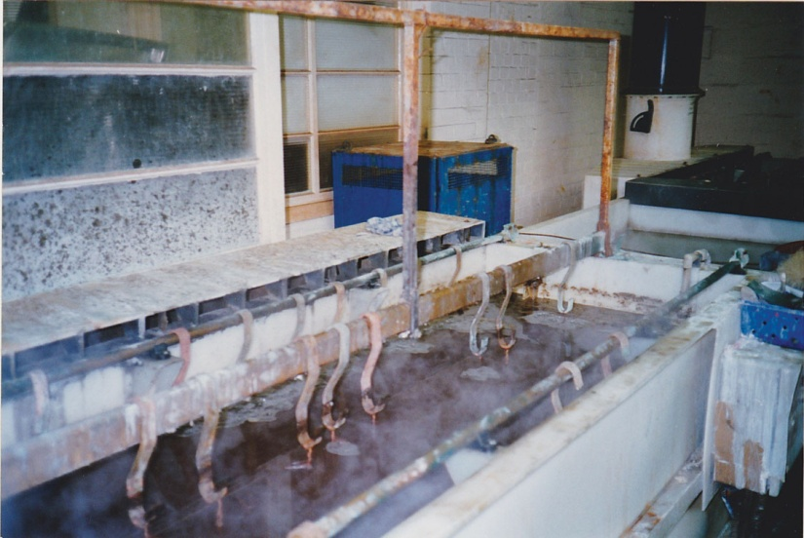
FIGURE 32.5 A Small Scale Electroplating Tank
Copyright © 2016 Elsevier Ltd. All rights reserved.

